Slide 1
React Calendar / Bundels
Dominik Engel
28.11.2018

Slide 2
React Google Calendar
https://github.com/crashspringfield/react-google-calendar
https://console.cloud.google.com/apis

Slide 3
Bundle
Bundle
Index.tsx
App.tsx
Calendar.tsx
User

Slide 4
Treeshacking
Material UI
Dialog
List
Card
Dialog Title
Dialog Content
ListText
ListImage
CardHeader
CardContent

Slide 5
Treeshacking
Material UI
Dialog
List
Card
Dialog Title
Dialog Content
ListText
ListImage
CardHeader
CardContent

Slide 6
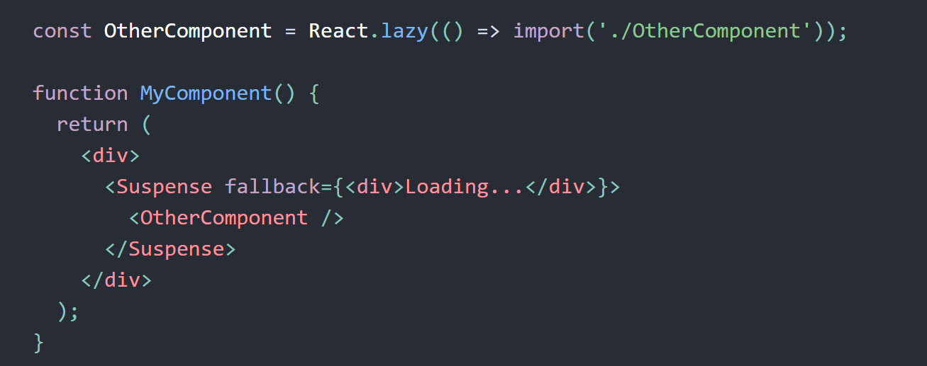
React.lazy

Slide 7
Danke für die Aufmerksamkeit

